Slide 1
Section 6.4 Notes
Roots and Radicals
MATH 1010 – K
Radicals (also called roots) are directly related to exponents.
The simplest types of radicals are square roots.
Radicals beyond square roots exist, but we will not explore them here.

Slide 2
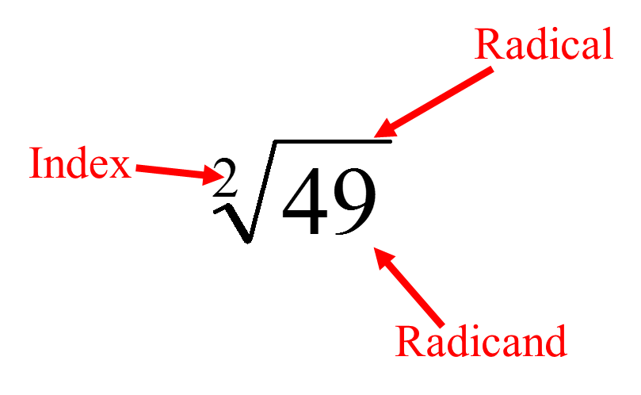
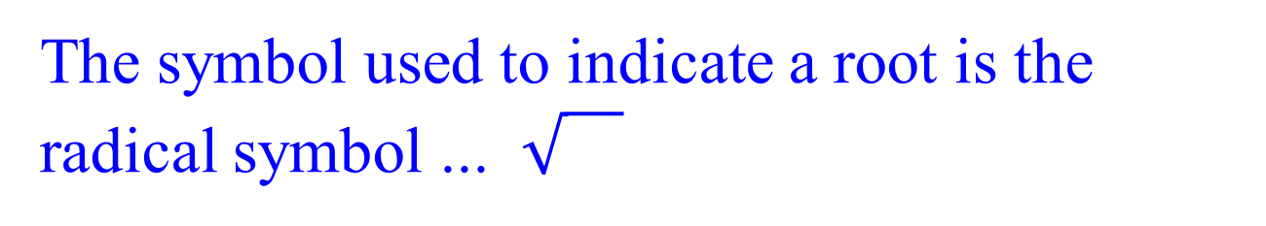
Roots and Radicals
MATH 1010 – K
The rules for radicals that you will learn work for all radicals – not just square roots.
The symbol used to indicate a root is the radical symbol ...
Every radical expression has three parts…
Radical symbol
Index
Radicand

Slide 3
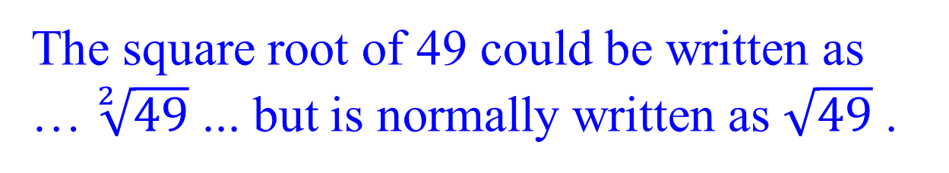
MATH 1010 – K
Roots and Radicals
The index of a radical is a whole number greater than or equal to 2.
The index of a square root is always 2.
By convention, an index of 2 is not written since it is the smallest possible index.
The square root of 49 could be written as … $\sqrt[2]{49}$ ... but is normally written as $\sqrt{49}$ .

Slide 4
Roots and Radicals
MATH 1010 – K
What does square root mean?
The square root of a number (or expression) is another number (or expression)…
…which when multiplied by itself (squared) gives back the original number (or expression).

Slide 5
Roots and Radicals
MATH 1010 – K
Example:
because
Also
because
has two answers:
7 is called the positive or principal square root.
-7 is called the negative square root, but it is not used as a “final” answer for a square root.

Slide 6
Roots and Radicals
MATH 1010 – K
What are the first 15 whole numbers that are perfect squares?
1, 4, 9, 16, 25, 36, 49, 64, 81, 100,
121, 144, 169, 196, 225

Slide 7
Roots and Radicals
MATH 1010 – K
principal square root
(don’t use negatives)
Examples:

Slide 8
Roots and Radicals
MATH 1010 – K
principal square root
(don’t use negatives)
Examples:

Slide 9
Roots and Radicals
MATH 1010 – K
Not all numbers or expressions have an exact square root as in the previous examples.
If a number is NOT a perfect square, then you CANNOT find its exact square root.
You could approximate these square roots with a calculator.

Slide 10
Roots and Radicals
MATH 1010 – K
Examples:
If a number is NOT a perfect square, then you might also be able to SIMPLIFY it.
What is the process to simplify a square root?

Slide 11
Roots and Radicals
MATH 1010 – K
If the expression is not a perfect square ...
1. see if you can rewrite the expression as
a product of two smaller factors...
2. where one of the factors is a perfect square.
3. Then, extract the the square root of
the factor that is a perfect square …
4. and multiply that answer times the
other factor still under the radical symbol.

Slide 12
Roots and Radicals
MATH 1010 – K
Examples – Simplifying Square Roots:
perfect square

Slide 13
Roots and Radicals
MATH 1010 – K
Not all square roots can be simplified!
Example:
cannot be simplified!
77 is not a perfect square …
and it does not have a factor
that is a perfect square.

